Slide 1
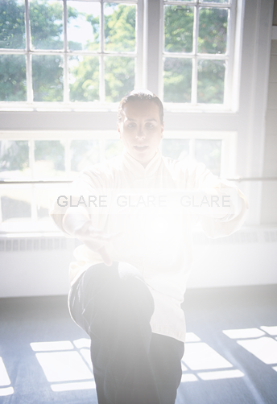
The Ultimate Hand-Held Glare Test
The Disability of Glare
BAM Deuce™
2 in 1 GLARE TESTER
Brightness Acuity Meters:
BAM Spot™
BAM Flood™
BAM Deuce™ (Both Flood & Spot)
Document & Demonstrate
Disabling Glare
for
Timely Surgical Intervention
BAM Flood™: Picture Window Glare
Normal
Cataract simulated
E
E
E
BAM Spot™: Headlight Glare
E
E
E
~ Measure with Confidence ~
Normal
Cataract simulated
AMA Optics, Inc.
11 ISLAND AVE
SUITE 1001
MIAMI BEACH, FL 33139 (786) 387-4834
www.amaoptics.com www.visionperformance.store
U.S. Patents 7,857450 & 8,038,297

Slide 2
Actual Clinical Case
Choose a Vision Chart
Qualifies for surgery
Standard brightness vision chart (85 cd/m²)
Qualifies for surgery
RAM® Prime XL
Or
Snellen Chart
BAM Deuce™
Comparison of BAM Flood™ to BAM Spot™
78 year old with cataract OS > OD and complains of glare from headlights. Green line indicates the threshold for qualifying for cataract surgery as per Medicare Guidelines, i.e., worse than 20/40 with glare test. BCVA is 20/20 OD and 20/30 OS and both eyes qualify for cataract surgery because of glare.
The RAM® Prime XL fitted with the reading chart and the brightness set at 85 cd/m² (dim) can be used as the vision chart at near for BAM testing. Any vision chart may be used, remember too bright of a chart will nullify the glare effect.
Packing List
BAM Deuce™
2. Battery charger
3. Trial Lens Holder
3. Lens Cloth 5. Operating Instructions
6. Spare (2) CR1220 batteries

Slide 3
INTRODUCTION
Glare testing is considered an appropriate part of the pre-op evaluation for cataract surgery (EYENET,1/2021). AMA Optics glare testers measure car headlights and picture window glare. The main application of the glare testing is to demonstrate, document, and monitor disabling glare, information that can assist in timing of cataract surgery or capsulotomy.
Medicare Guideline for timely Invention
“Coverage for cataract extraction is indicated if there is a glare component, glare testing which reduces visual acuity to less than 20/40.” Check with your insurance provider for specifics rules in your region.
AMA Optics, Inc. Glare Testers
BAM Flood™ (Floodlight Acuity Meter)
Mimics sunshine streaming through a picture window
2. BAM Spot™ (Spotlight Acuity Meter)
Mimics car headlights, aka “ High-Beamer™”
3. BAM Deuce ™ (Flood glare Plus Spot glare) Why test for Glare? How do the testers work?
Glare can be very dangerous and disabling for those having cataract, posterior capsular opacity, or corneal opacities. In most cases early cataract surgery or capsulotomy cures the problem. The most common glare complaint is the fear of having an accident at night due of the blinding glare from on-coming automobiles.
Bright sunshine is another common source of glare complaints. Sunshine streaming through the window can be annoying during work or social situations.
Key to diagnosing the presence and documenting the severity of disabling glare is Glare Testing. AMA Optics markets three Hand-Held glare testers. The BAM Flood™ measures floodlight glare and the BAM Spot™ measures spotlight glare. The BAM Deuce measures both.
The principle behind both the BAM Flood™ and the BAM Spot™ is similar: In a light scattering medium, the brighter the light the more light scatters and the more visual acuity degrades. In an eye with no disease and no light scatter, glare testing does not significantly reduce vision. However, in an eye with light scattering cataract, posterior capsule, or corneal disease even a slight increase in brightness can cause drastic vision loss. The test is simple: (1) test the Snellen acuity under normal lighting, (2) test the Snellen acuity while viewing through the glare tester, and (3) compare the results. In USA, when glare testing reduced the vision to less than 20/40, glare is considered significant, and generally qualifies for cataract surgery.

Slide 4
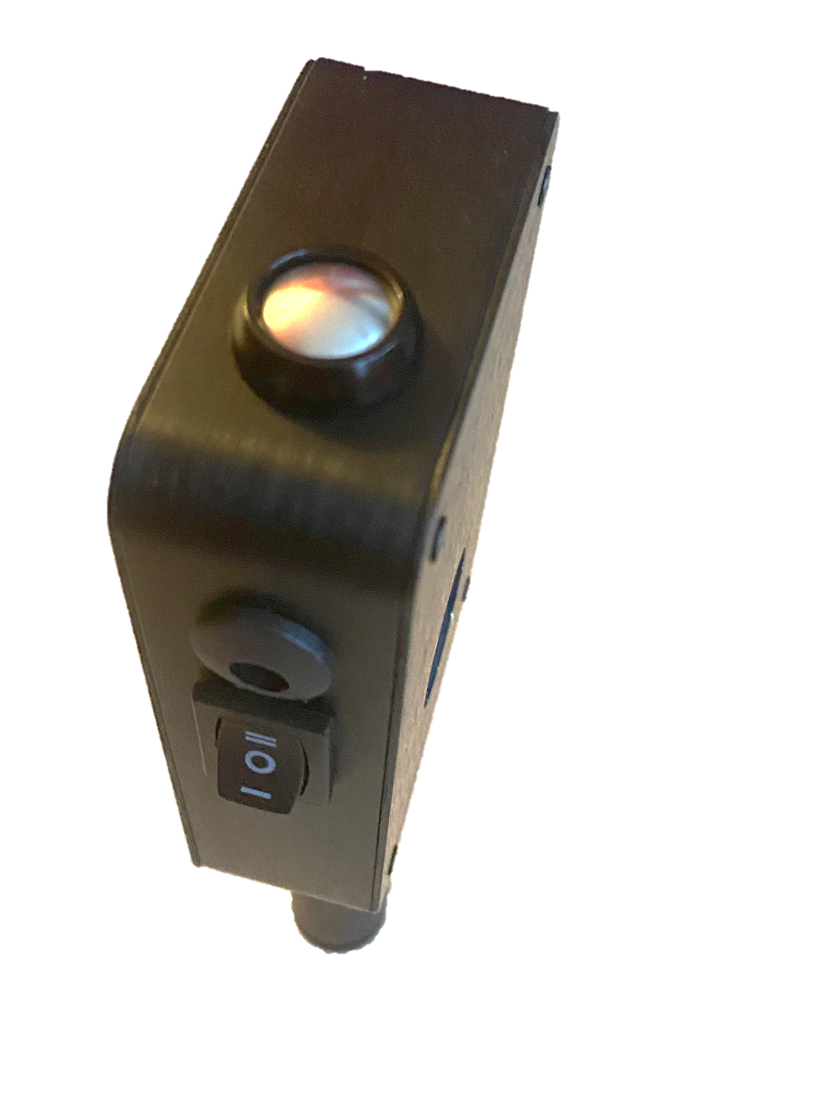
The Flood mode displays a uniform bright field of light produced by a single LED bulb illuminating a white reflective bowl. The Spot mode displays two lights, one on either side of the line of sight that mimics on-coming headlight. The lights are two side-side 2 mm LED bulbs. A slide potentiometer attenuates the light brightness from Low to High brightness on a scale of 8 levels. The chart on page 5 shows the exponential relationship between levels and brightness (kLUX).
Sliding the potentiometer
down increases brightness
Side view
Switch measures
Battery charge
level
Vision Chart Any vision chart can be used but it is important that the chart luminance be of standard brightness, 85 cd/m². A bright chart may give false negative glare testing results.
Glare Testing – preparations & instructions
Do not dilate the pupil prior to testing.
Inspect the patient’s glasses or contact lenses for debris or scratches that could interfere with glare testing and give a false positive result.. ♦ Instruct the patient to hold the glare tester close to their eye, glasses or the Carrier Frames of the RAM SYSTEM.
Charger Port
Switch Selects
Spot ON
OFF
Flood ON
Rear view

Slide 5
♦ Instruct the patient to hold the glare tester close to their eye, glasses or the Carrier Frames.
Testing can be individualized. One method is to set the vision chart to the 20/40 lines and start with the BAM on LOW (1 level). While the patient holds the RAM Deuce in the right hand, have the patient move the slide switch down with the index finger until the chart letters become indistinct. Have the patient validate the endpoint by crossing and recrossing the endpoint by brightening and diming with the switch. Alternatively, the examiner can control the switch.
Fig. 2. Brightness vs. Light-ON Time
Fig. 3. Brightness vs. Potentiometer Scale
Fig. 1. Power level vs Light-ON Time

Slide 6
Trial Lens Holder
The lens holder attaches to the BAM by four tiny magnets and is held securely in place. The spherical and cylindrical lenses snap into place and can be easily rotated to the desired axis. Lenses attach distal to the glare light and do not artificially increase glare. Lenses may represent full refraction, over-refraction, or near add. Trial lenses are not included with the glare tester. Reposition the Len Hold (vertical or horizontally) to accommodate the cylinder axis.
Operation
Battery Power Level and Recharging: Press the top switch momentarily and the battery voltage appears on the voltmeter. Full charge of 3.3 volts will power for 16 hrs. of continuous usage, about 500 exams. Recharge when level is 3.1 volts or less. Recharging monthly should be adequate.
Mode selection: Left side switch, select 1. Spot 2. OFF 3. Flood
Brightness selection: Right side sliding switch Slide down to brighten.
Replacing the coin batteries: 1. Remove the 5 silver Phillips head screws on the rear panel. 2. Retract slightly the brass retainer to release the battery 3. Insert new battery with + pole up. Insert the battery beneath retaining clips opposite the brace retainer, then snap into place.
Technical Data
Weight 6 ounces
Battery for bulbs: lifep04, 3.6 volts Coin Battery for voltmeter: CR1220, 3 v, 2 each
Bulb for Spot: 2 mm LED
Bulb for Flood: 1 watt L.E.D
Charger: red = charging, green = charged
Warranty BAM Flood: One Year, parts and labor

