Slide 1
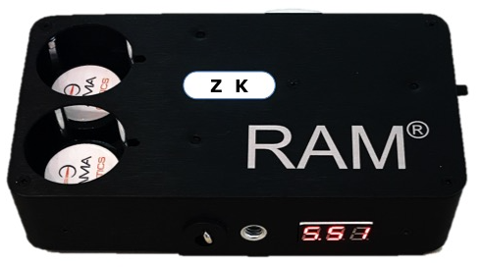
RAM® Prime★
Retinal Acuity Meter Clinically Proven
21 Years of Testing
71 Owners
judge their
Retinal Acuity Meters
“Simply the Best”
Improves Patient Care
100% (71/71)
Improves Informed Consent
100% (71/71)
100% (71/71)
Improves Surgical Cases Selection
Quick-Change Chart
Choice of Charts
20/20 to 20/400
Dial-in Brightness
Rechargeable
Lanyard Switch
Tripod Mount
Three Years Warranty
Identifies Operable Surgical Cases “Thought” Inoperable
92% (65/71)
100% (71/71)
Changed My Practice Pattern
© 2014 AMA Optics, Inc.
U.S. Patent No. 5,398,085
U.S. Trademark No. 2,776,911
AMA Optics, Inc.
11 Island Ave, Suite 1001.
Miami Beach, FL 33139
1-877-744-EYES (3937)
305-321-7855
www.amaoptics.com
www.visionperformance.store
~ Measure with Confidence ~

Slide 2
The RAM® measures the function of the macula for (1) diagnostic purpose and for (2) forecasting the outcome of cataract surgery. In comparison, OCT does not predict outcomes (function), the scan shows the shape of the eye in fine detail. The RAM® predicts function best when pre-op acuity is 20/200 or better.
Ease of Operation: The RAM® is simple to operate and takes only 1 minute per eye. The RAM® is used in conjunction with a multi-perforated Pinhole-Lens Clip-on and near vision correction.
Push-Button Switch: Momentary function with a touch, full ON with a deep press (may need to use the small finger).
Chart Brightness: The standard RAM® brightness is 3000 cd/m² for potential vision testing, lower brightness is used to measure current acuity and higher brightness is available to penetrate more opaque cataracts. By adjusting the slide-switch the voltage changes to achieve the desired brightness. The graph on the label Illustrates the relation between voltage and brightness.
Testing Distance: Two retracting cords, 16 and 8 inches are built-in and rest in the retractor cave. Testing at 16 inches measures acuity from 20/20 to 20/200. Testing at 8 inches measures acuity from 20/200 to 20/400. Parking the retractor over the slit, keeps the retractor out of the retractor cave for easy reuse. A Low Vision adaptor is available for acuities to 20/1600.
Quick-Change Charts: RAM® Prime has the option of exchangeable charts. Charts are available for either potential vision (brighter) or current acuity (dimmer). The chart types are Letters, Numbers, Tumbling E, Landolt C, custom and ETDRS series of 5 charts.
Chart Label: The label on the back shows the acuity index and Volts/Brightness graph. The label is reversible: on the standard model, one side has letters and the reverse side has Landolt C.
Lanyard Option: Maintaining the precise testing distance is easy with the adjustable lanyard. From around the patient’s neck, the lanyard attaches to lanyard switch of the RAM®. Use the retractable cord of the RAM® to set the testing distance, then slide the lanyard fastened to fix the distance. With the patient holding the RAM®, the chart light turns on when the lanyard is extended and taunt. Lanyards are sold separately.
MODELS 1. RAM® Prime
Single Chart 2. RAM® Prime XL
Exchangeable Charts
2. RAM®ETDRS Mobile 5 RTDRS Charts
Chart Options
Potential Vision Charts
Current Vision Charts (more opaque)
Chart Types
Letters
Numbers
Landolt C
Tumbling E
ETDRS
Custom
Packing List: RAM® RAM® RAM®
1. Instrument Prime Prime XL ETDRS
2. Charts 1 1 5
3. Extra Charts No Option Option 4. Carrier Frames Yes Yes Yes
5. Trial Frame Pinhole Yes Yes Yes
5. Traditional Pinhole Clip-on (2) Yes Yes Yes
6. Panoramic Pinhole Clip-on Option Option Yes
7. Occluding, Magnetic Yes Yes Yes
8. Low Vision adaptor Option Option Yes
8. Charger Yes Yes Yes
9. Lanyard Option Option Yes 10. Lens Cloth Yes Yes Yes
11. Manual Yes Yes Yes
1
2

Slide 3
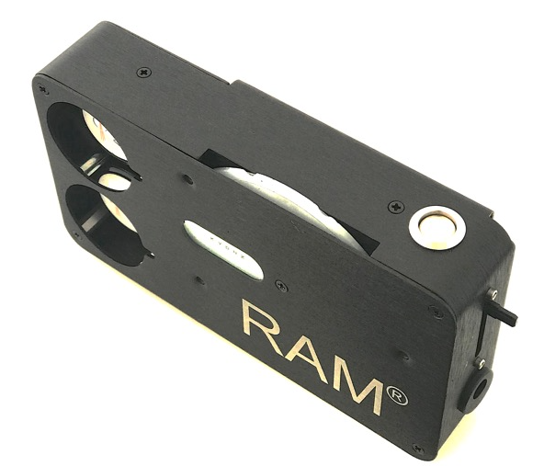
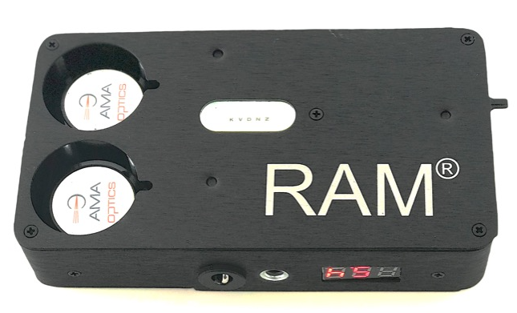
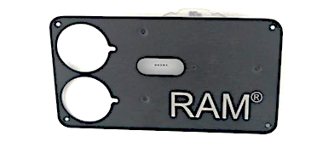
TESTING PROTOCOL
Retinal Acuity Measurement (Potential Vision) Pre Test details
Test in a semi dark room.
Avoid Bright Light Exposure Prior To Testing
(No retinal exam or glare testing within 5 minutes of retinal acuity testing).
Pupil dilation is optional
Setup
Use Potential Vision Chart with ≥3000 cd/m² brightness
Distance lens correction plus +2.5 lens 1.Trial frames with corrective lenses
2. Pinhole-Lens Clip-on over
1. Distance glasses or bifocals (Clip-on Lens Down) 2. Reading glasses (Clip-on Lens Up)
3. Occlude the opposite eye
Pinhole, Traditional or Panoramic
Position RAM® 1. 16 inches for up to 20/200 acuity
2. 8 inches for low vision, worse than 20/200 acuity
Test Instruct the patient to find the bright light through the pinholes and read the line of letters. Inform the patient that some of the pinholes provide a better view of the letters. Ask the patient to select the clearest view. Start with the 20/200 letters and progress to the smallest letters. Challenge the patient to read smaller letters because some letters are more readable. For example, if letters are missed on the 20/60 line, try the 20/50 and 20/40 lines before stopping.
Either the Non-transparent traditional pinhole disc or the Panoramic Pinhole disc may be used. The Panoramic pinhole disc is transparent between the pinholes. The benefit of the Panoramic pinhole disc is that the patient views their current vision between the pinholes and their potential vision through the pinhole. This allows the patient to compare their current acuity to the acuity they can expect after cataract surgery. Normal: better acuity between the pinhole. Defective media: better vision within the pinhole.
1
2
7
6
5
3
4
10
8
11
Quick-Change Top (XL Model)
7. Retracting cord
8. Voltmeter
9. Tripod mount
10. Lanyard switch
11. Quick-Change Top
Chart Disc
On-Off Switch
Slide switch (rheostat)
Charging connector
Viewing window
Slit for cord
3
4

Slide 4
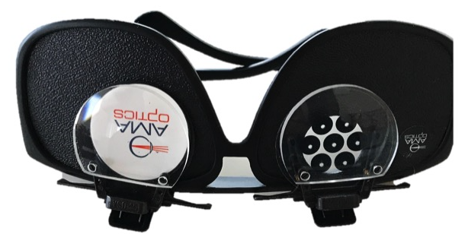
TESTING PROTOCOL
B. Visual Acuity Measurement (Current Vision) Setup
Trial Frames with near correction or Patient’s distance plus +2.50 Diopter add.
1. Use Current Acuity Chart
2. Adjust light to 85 cd/m² using voltmeter and graph
3. No pinhole
4. Occlude opposite eye
Position RAM® 1. 16 inches for up to 20/200
2. 8 inches for 20/200 to 20/400
3. 2 inches for 20/400 to 20/1600 (with low vision adaptor)
Test Start at 16 inches with the 20/200 letters and progress to 20/20 letters. Challenge the patient to read smaller letters because some letters are more readable. For example, if letters are missed on the 20/60 line, try the 20/50 and 20/40 lines before stopping.
Battery Charging:
Use only the charger provided. Simply attach the charging cable to the RAM®. Recharge before the maximum voltages declines below 6.5 volts. When fully charged, the voltmeter will read between 8.7 and 9.2 volts.
Depending upon the use, weekly recharging is usually sufficient.
For 220, use a simple connecting adaptor between the wall electrical outlet and the prongs of the charger.
Charger is indoor use only
Keep away from children
Specifications
Brightness (adjustable)
ETDRS 85 cd/m²
RAM® (Potential Vision) 3000 cd/m²
Super Bright RAM® >3000 cd/m² (adjustable)
Testing Distance
16 inches (Up to 20/200)
8 inches (Up to 20/400)
2 inches (Up to 20/1600) (with low vision adaptor)
Battery: 9 volt NiMH rechargeable
Carrier Frames with Pinhole-Lens clip-ons
.
13
14
12
15
14
12. Panoramic Pinhole-Lens Clip-on
13. Occluder, magnetic
14. + 2.5 D Lens of Pinhole-Lens Clip-on
15. Traditional Pinhole-Lens Clip-on
5
6

